Slide 1

Virtual Environment
Anaconda

Slide 2

How to set up a virtual environments using conda for the Anaconda Python distribution
A virtual environment is a named, isolated, working copy of Python that that maintains its own files, directories, and paths so that you can work with specific versions of libraries or Python itself without affecting other Python projects.
Virtual environments make it easy to cleanly separate different projects and avoid problems with different dependencies and version requirements across components.
The conda command is the preferred interface for managing installations and virtual environments with the Anaconda Python distribution.
If you have a vanilla Python installation or other Python distribution, see virtualenv

Slide 3

Check conda is installed and in your PATH
Open a terminal client.
Enter conda -V into the terminal command line and press enter.
If conda is installed you should see something like the following.

Slide 4
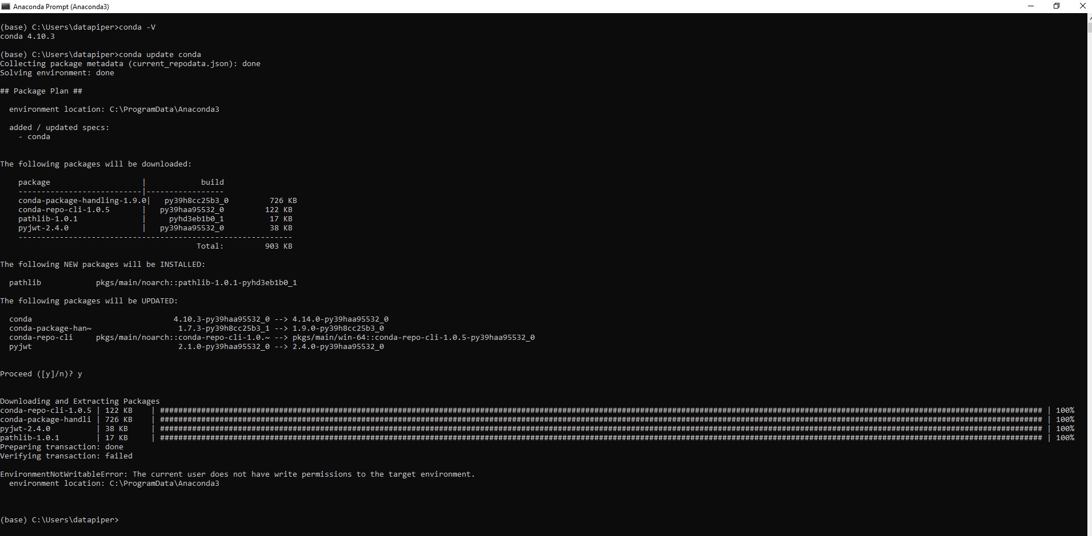
Check anaconda is upto date
conda update conda

Slide 5
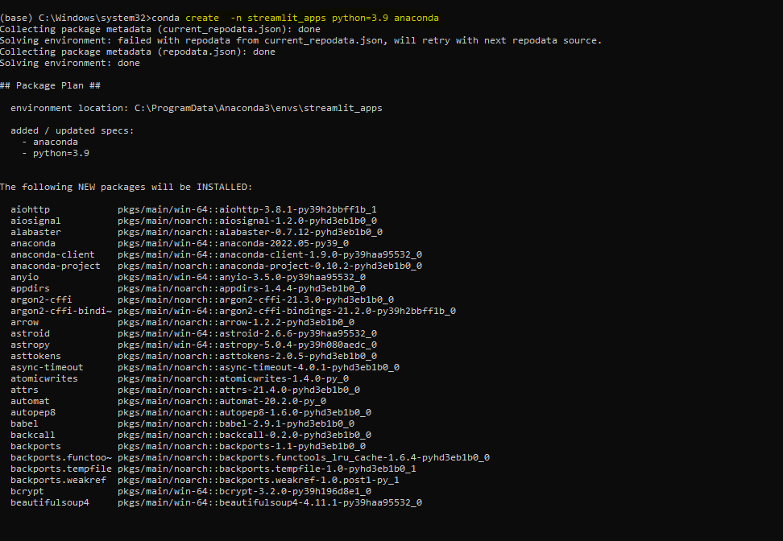
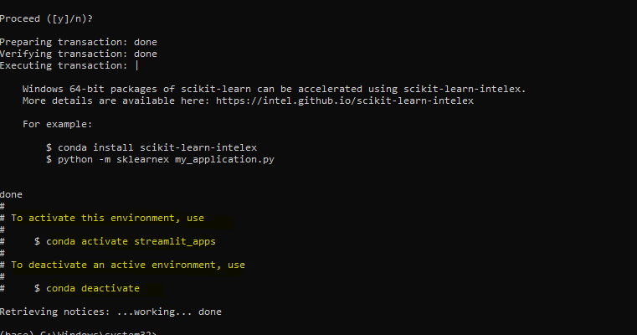
Create a Virtual env
In the terminal client enter the following where yourenvname is the name you want to call your environment, and replace x.x with the Python version you wish to use. (To see a list of available python versions first, type conda search "^python$" and press enter.)
conda create --name streamlit_apps python=3.9

Slide 6
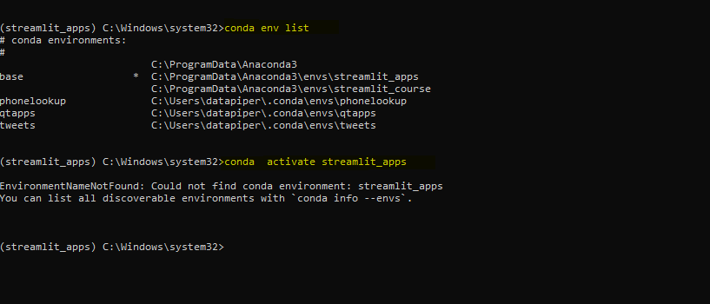
Activate your virtual environment
To activate or switch into your virtual environment, simply type the following where your envname is the name you gave to your environment at creation.
List all venv available
conda env list
To activate
conda activate streamlit_apps

Slide 7
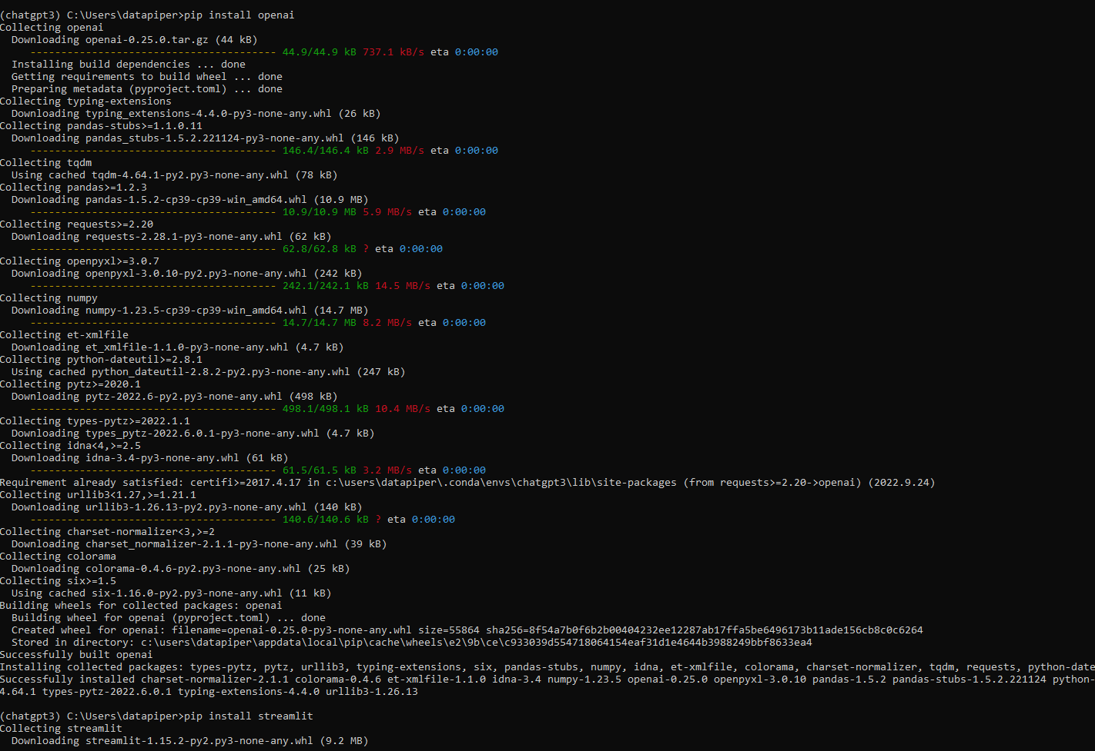
Pip Install two libraires we need
Install Open AI library
pip install openai
Install Streamlit library
pip install streamlit

Slide 8

Check Open AI and Streamlit are installed
(venv name) C:\Users\<your_pcname>python
Python 3.9.15 (main, Nov 24 2022, 14:39:17) [MSC v.1916 64 bit (AMD64)] on win32
Type "help", "copyright", "credits" or "license" for more information.
>>> import openai
>>> import streamlit as st
>>> exit()

Slide 9
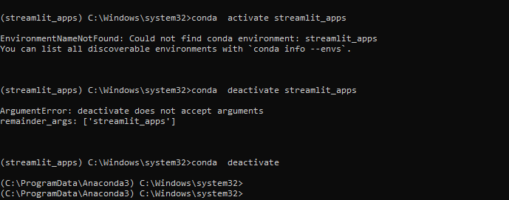
To deactivate your venv
conda deactivate

